Slide 1

SINGAPORE TOURISM ANALYSIS
GROUP 3

Slide 2
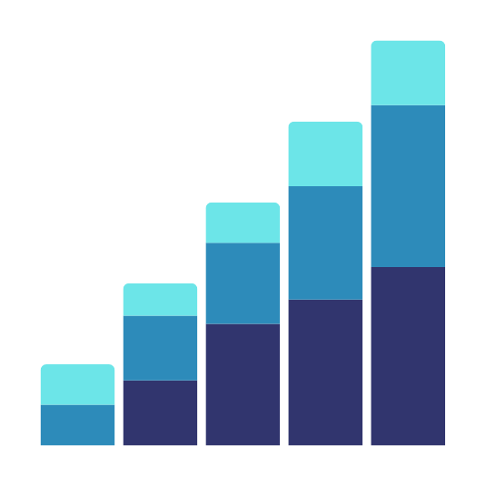
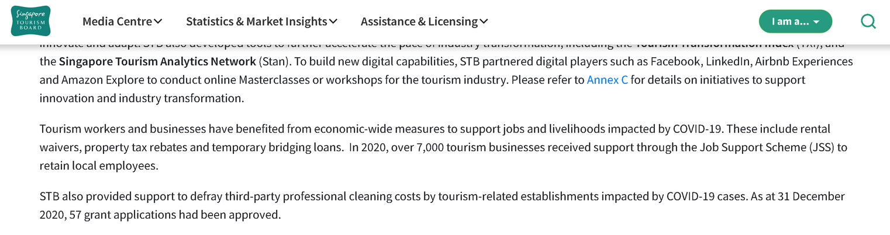
WHY IS TOURISM IMPORTANT?
https://www.stb.gov.sg/content/stb/en/media-centre/media-releases/Singapore-Tourism-Sector-Emerges-From-2020-With-Greater-Resilience-and-Reinvention.html
Tourism plays a huge part in Singapore’s economy.
It also provides a livelihood for people in Singapore by providing jobs.

Slide 3
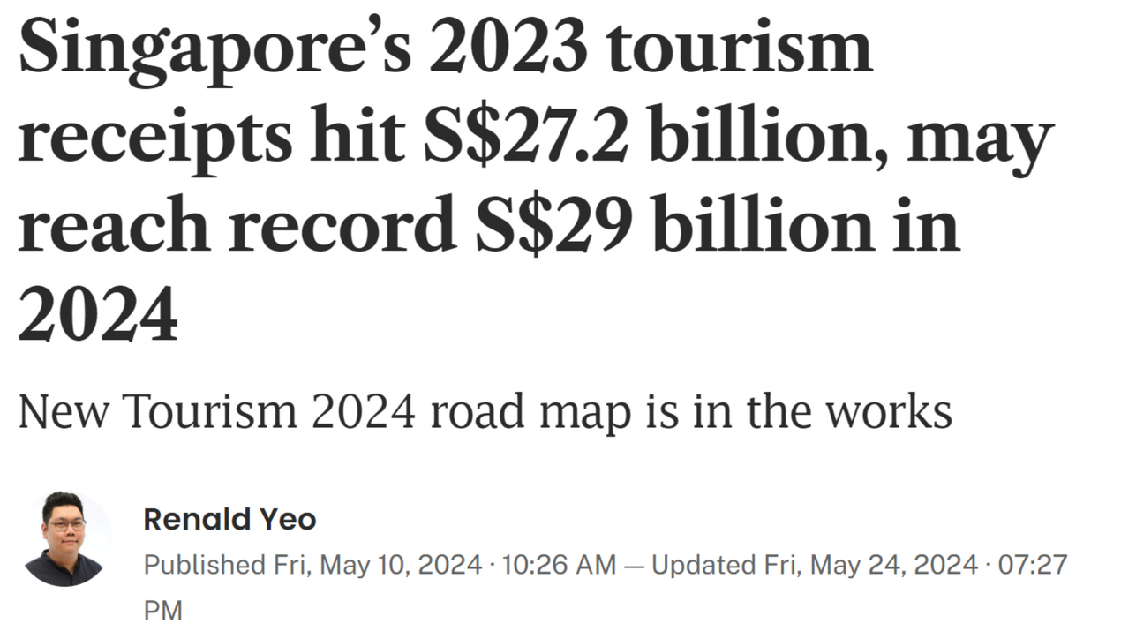
TOURISM IN SINGAPORE
As of 2023...
Singapore’s tourism sector makes up of 4% of Singapore’s Gross domestic product.
This is equal to 27.2 billion SGD.
https://www.stb.gov.sg/content/stb/en/media-centre/media-releases/Singapore-Tourism-Sector-Emerges-From-2020-With-Greater-Resilience-and-Reinvention.html

Slide 4
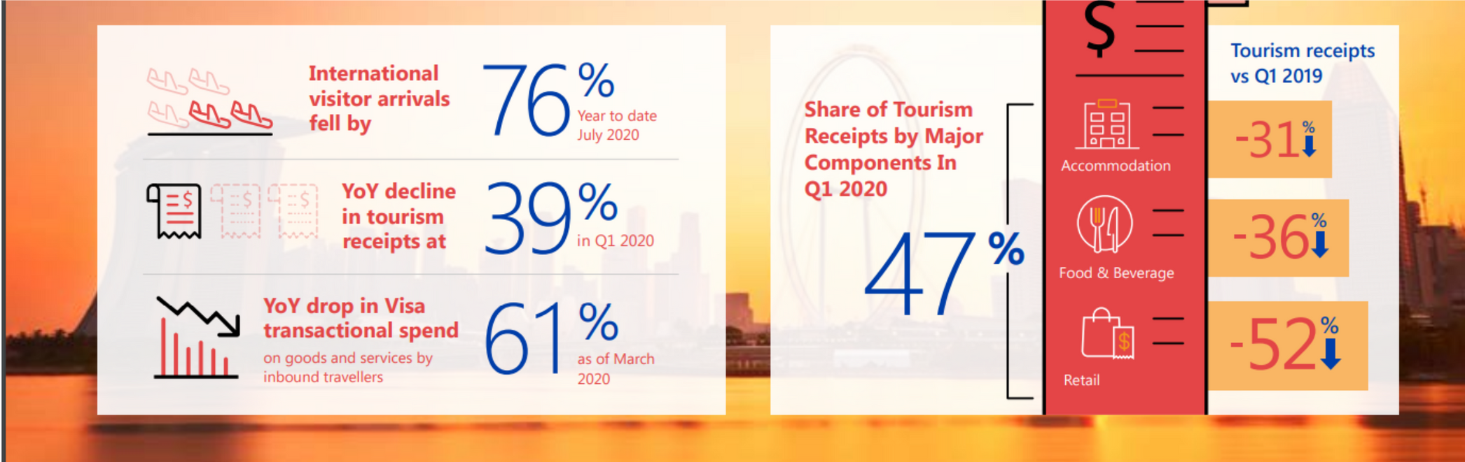
BACKGROUND
Back in 2020, when COVID-19 severely impacted the tourism sector…
https://www.stb.gov.sg/content/dam/stb/documents/mediareleases/Impact%20of%20Covid-19%20on%20tourism%20in%20Singapore%20and%20the%20road%20to%20recovery%20and%20transformation%20by%20STB%20and%20Visa.pdf

Slide 5
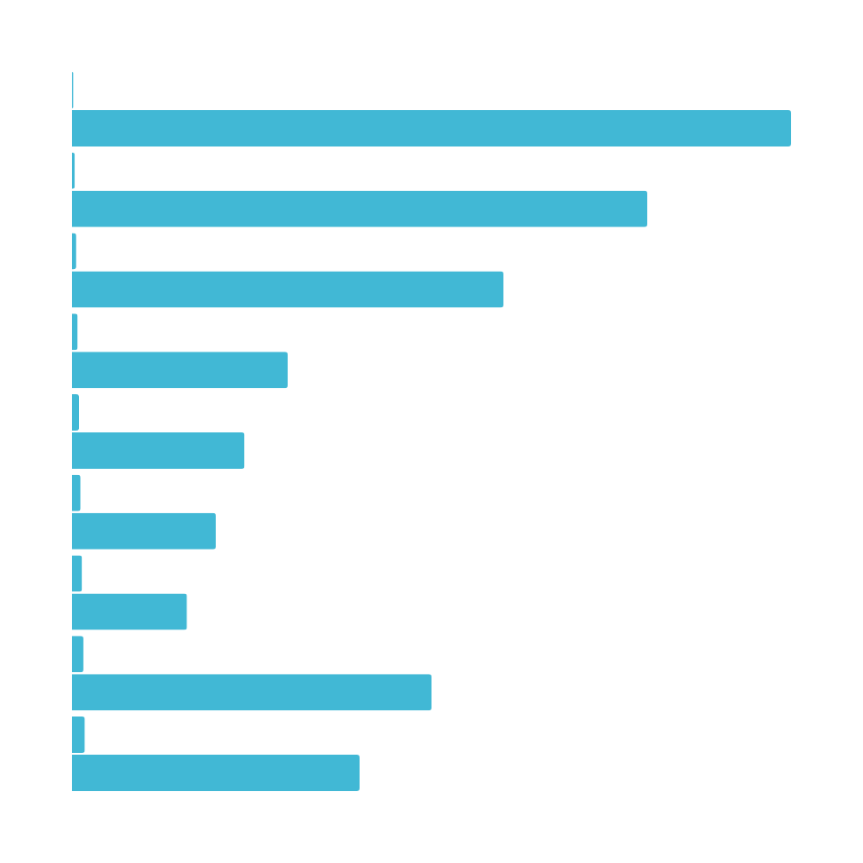
Current Problem
Although Singapore’s tourism sector has greatly recovered, and is about to reach a pre-pandemic tourism level from 2019, getting back on track.
How can we ensure that Singapore’s tourism sector remain consistently growing, or even increase in the rate of growth?

Slide 6
OUR BUSINESS OBJECTIVES
In order to allow Singapore’s tourism sector to recover, we must fulfil either one of these two conditions:
Increase Tourist Arrival Rate.
Increase Tourist Receipt.
THEREFORE, OUR BUSINESS GOALS IS TO IDENTIFY FACTORS THAT WILL ATTRACT MORE TOURISTS TO COME TO SINGAPORE AND SPEND MORE TOURIST MONEY, SO THAT WE CAN IMPROVE SINGAPORE’S TOURISM RECEIPT.

Slide 7
OUR DATA MINING GOALS
Find the demographics of tourists coming to Singapore.
Types based on: Gender, Age, Race, Citizenship etc.
2. Identify the most popular tourist spendings.
Which category: Food, Accommodation, Shopping etc.
3. Identify if we can still utilize revenge tourism
Look into pre covid and post covid to see if theres still potential for growth

Slide 8
DATA SOURCES:
Tourist Receipts/Spendings: https://tablebuilder.singstat.gov.sg/table/TS/M550371#
Tourist Demographics (age/gender etc): https://tablebuilder.singstat.gov.sg/table/TS/M550241
Hotel Stats: https://tablebuilder.singstat.gov.sg/table/TS/M550081
Country of arrivals: https://tablebuilder.singstat.gov.sg/table/TS/M550081

Slide 9
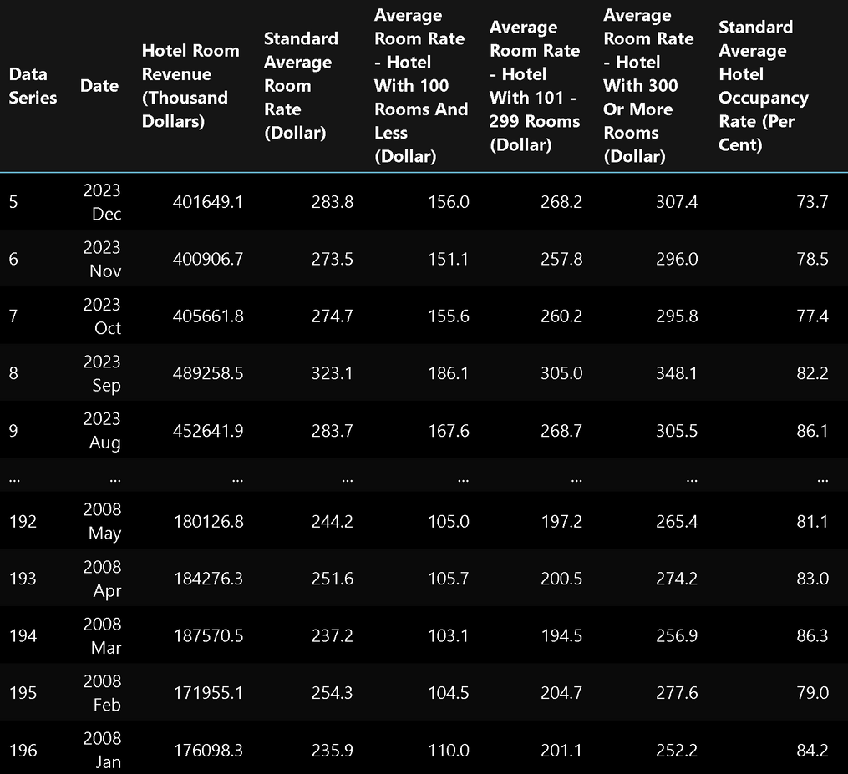
DATA CLEANING
Formatted the Date such that it spans from the start of 2008 to the end of 2023.
Ensured column names and units are uniform.
Used Transpose function to swap the rows and columns to make the date the index

Slide 10
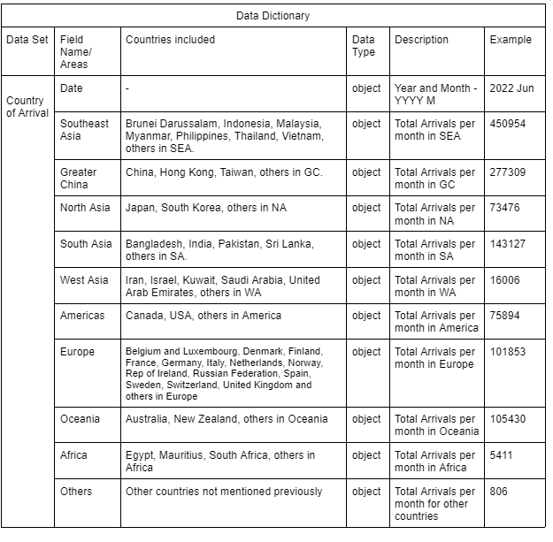
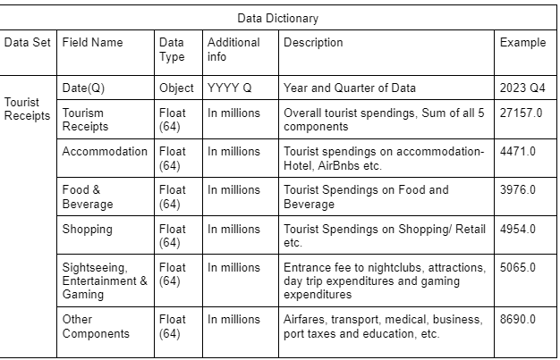
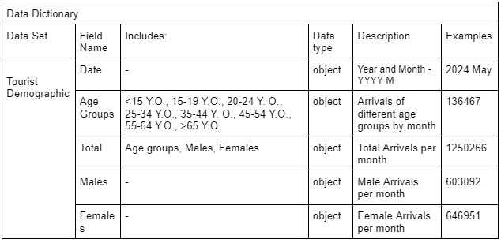
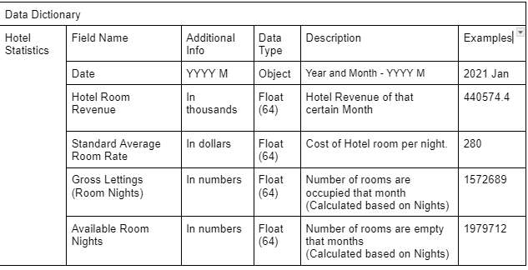
DATA DICTONARIES

Slide 11
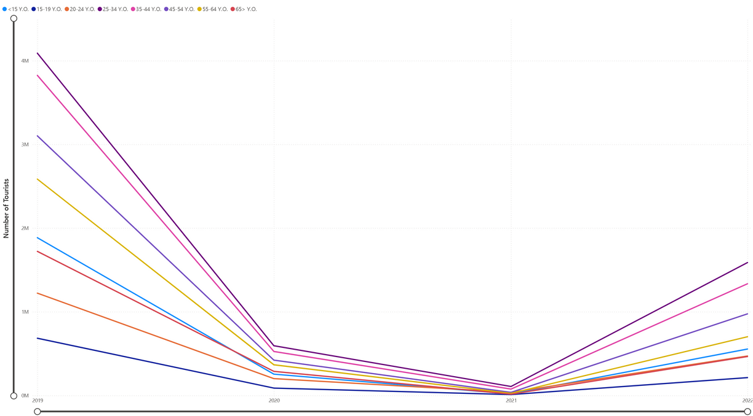
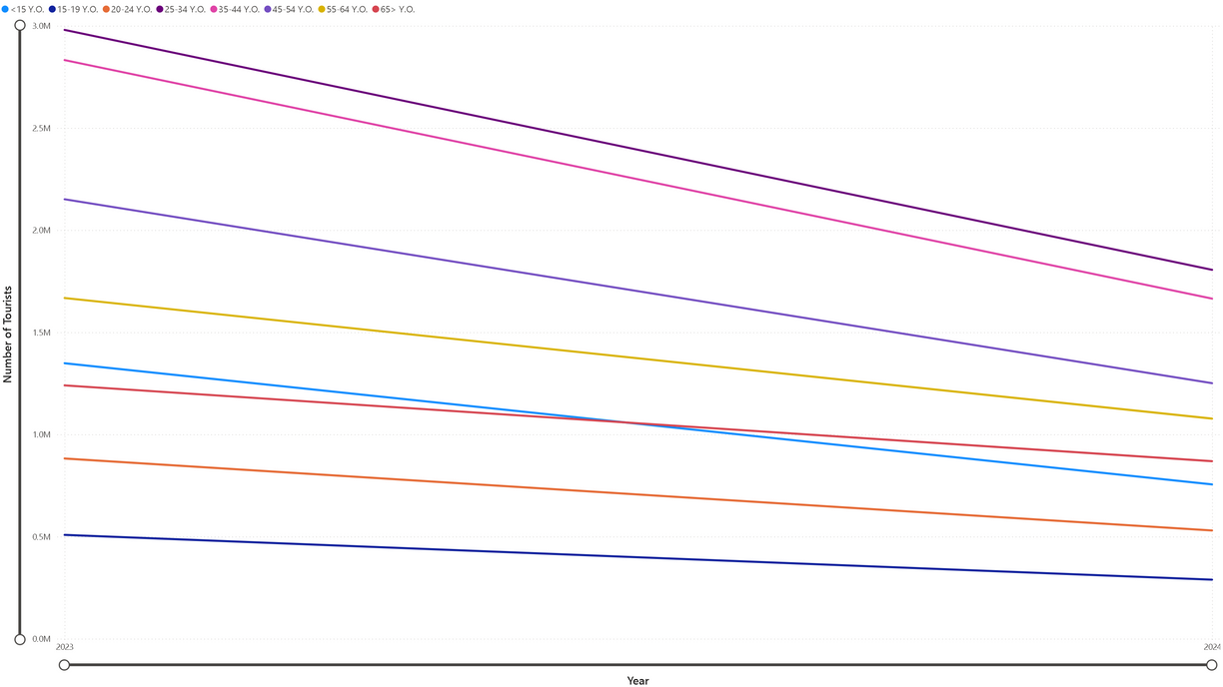
NOTES:
There is a sharp drop in 2020 due to Covid-19
2024 data is not completed, we only have data up till May-June.
2019-2023 Data
2024 Data

Slide 12

DATA MINING GOAL: DEMOGRAPHICS OF TOURISTS

Slide 13
DEMOGRAPHICS OF TOURISTS
Identify the demographics of the tourist coming to Singapore. This includes:
2.Gender of Tourists
4. Top Months of Arrival
Age of Tourists
3. Country of arrival
By identifying the top demographics, we can alter the price or create promotions of plane tickets or activities that they might be interested in.
This will attract more tourists to come to Singapore and spend more money.

Slide 14
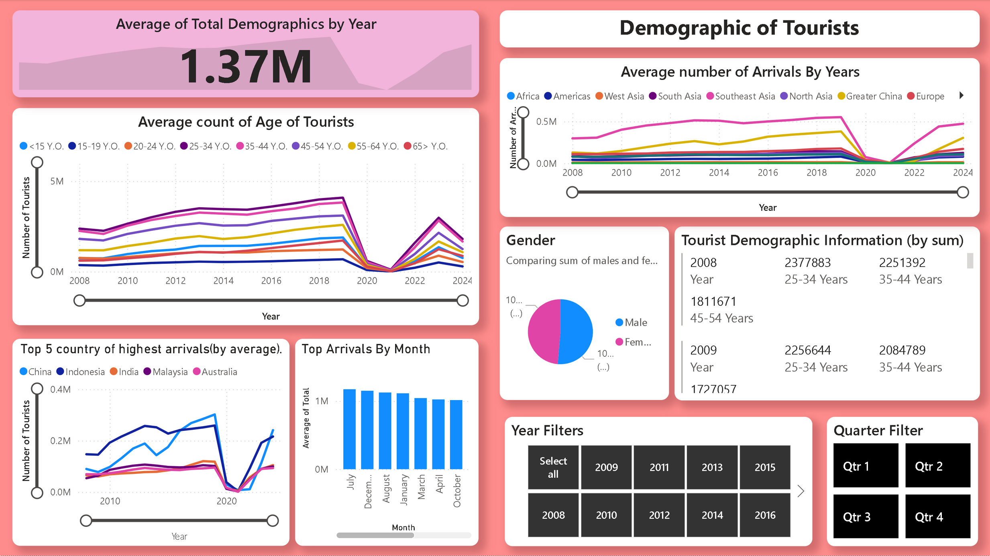

Slide 15
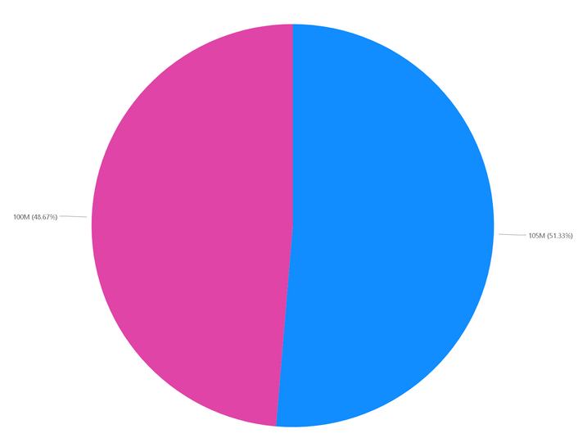
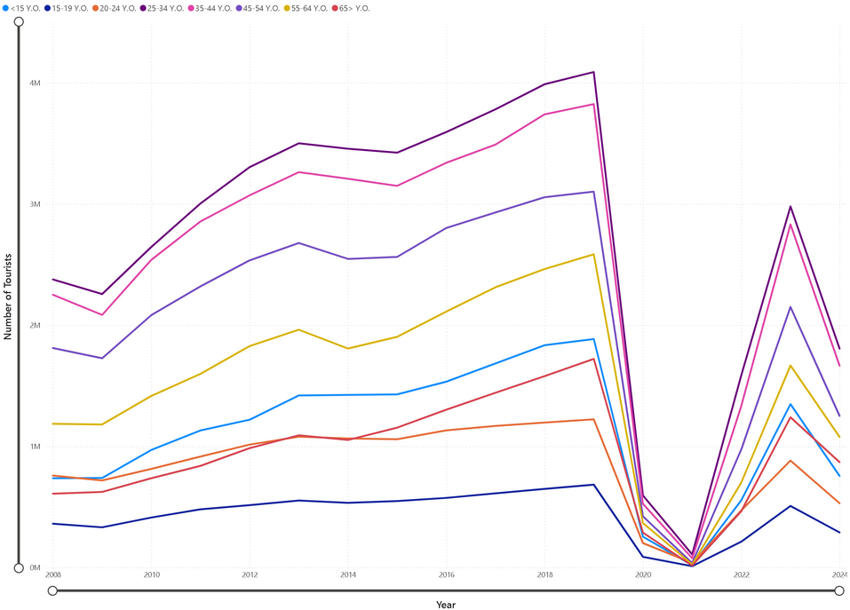
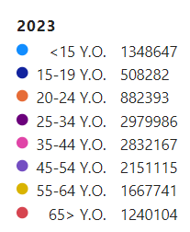
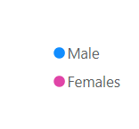
ANALYSIS
Gender of Tourists
Age of Tourists
The genders are divided almost evenly, 48.67% (Female) and 51.33%(Male)
2. The top 3 age groups visiting Singapore are: “25 to 34 Year Olds”, “35-44 Year Olds” and “45-54 Year Olds”.

Slide 16
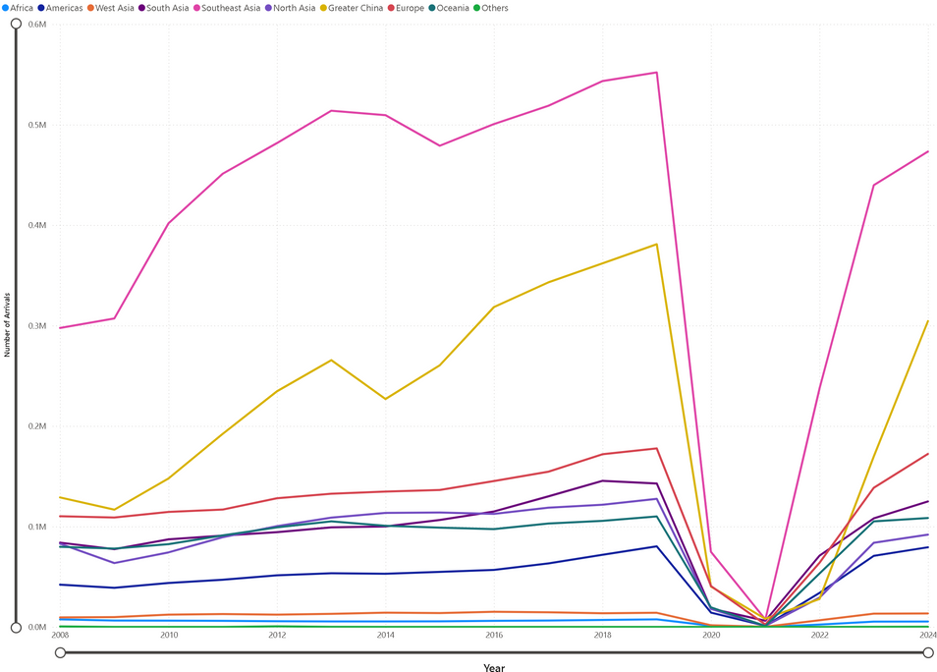
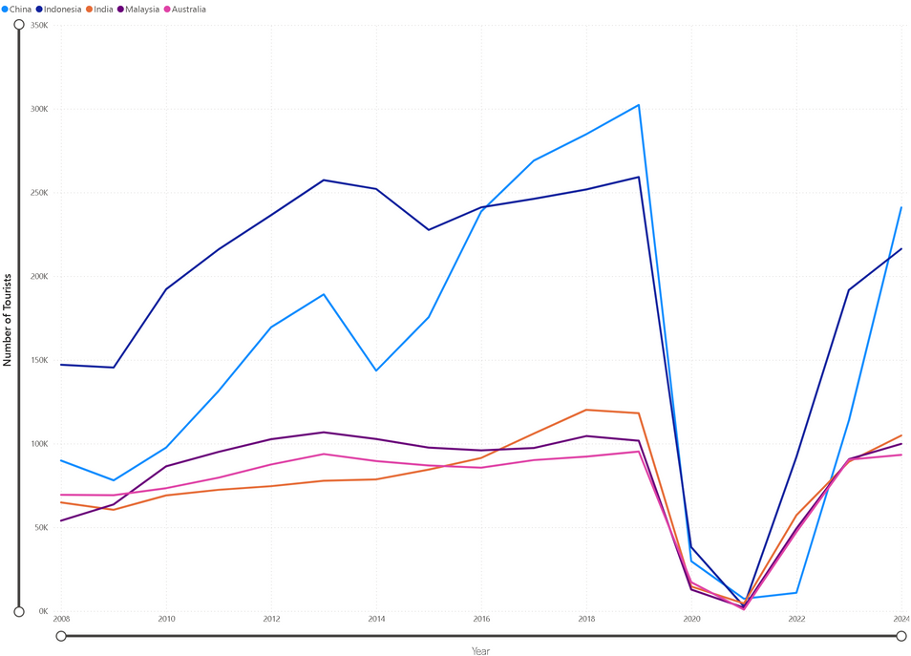
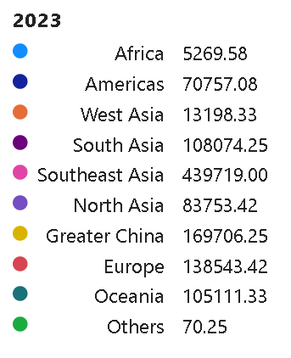
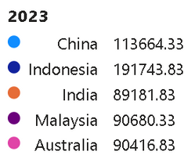
ANALYSIS
Areas of Arrivals
Top 5 countries
3. While the largest demographic of tourists are from Southeast Asia, the top countries where tourists are arriving from are: China (Greater China), India(South Asia), Indonesia (Southeast Asia), Malaysia (Southeast Asia) and Australia (Oceania).

Slide 17

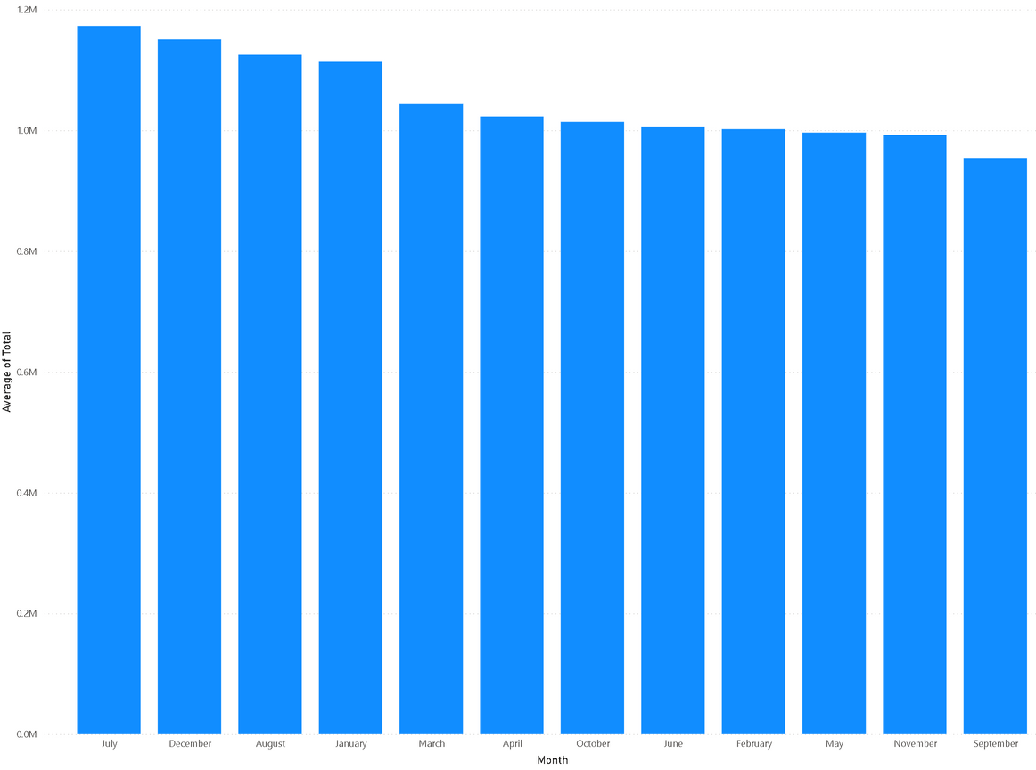
ANALYSIS
4. The top 3 months where tourists often arrive in are: July(1.17M), December(1.15M) and August(1.13M).

Slide 18
RESULTS
Based on our analysis, we can create promotions suited for these demographics. For example, we can:
alter the plane prices for the top 5 countries.
create deals and promotions for activities that tourists aged 25-54 year old's prefer, such as sightseeing
create these promotions when tourists are more likely to come, such as July and December.
Doing so will attract more tourists to come to Singapore, hence increasing tourist arrival and receipt.

Slide 19

DATA MINING GOAL: TOURIST SPENDINGS

Slide 20
TOURIST SPENDINGS
Our second data mining goal is to identify the factors that tourist often spend money on. This includes
identifying what are the top earning categories, (accommodation, shopping, F&B)
identifying the time span of the year which has the highest spendings by tourists.
By doing this, we can alter the prices of said popular categories (Promotions/Discounts) during peak tourist revenue periods, attracting even more tourists to come to Singapore, or profit even more.

Slide 21
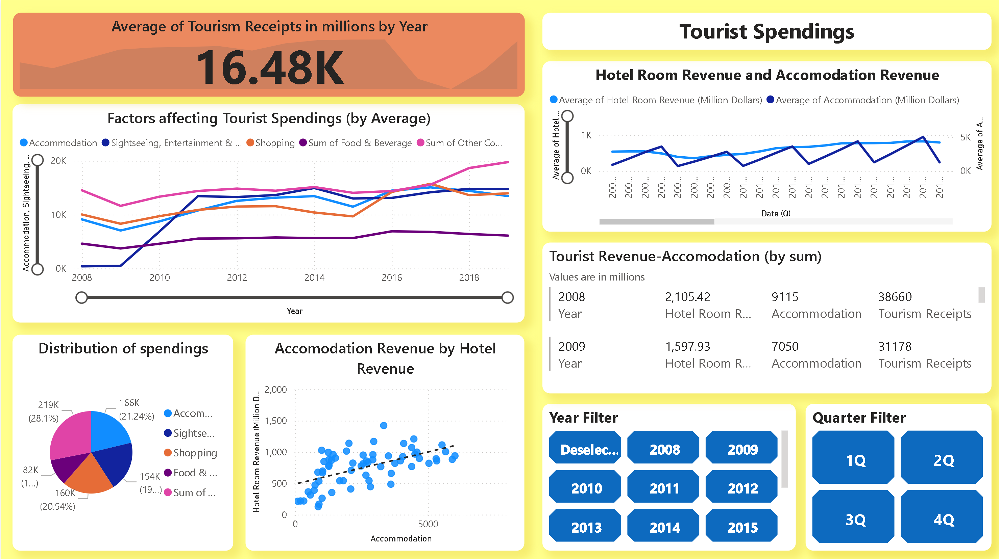

Slide 22
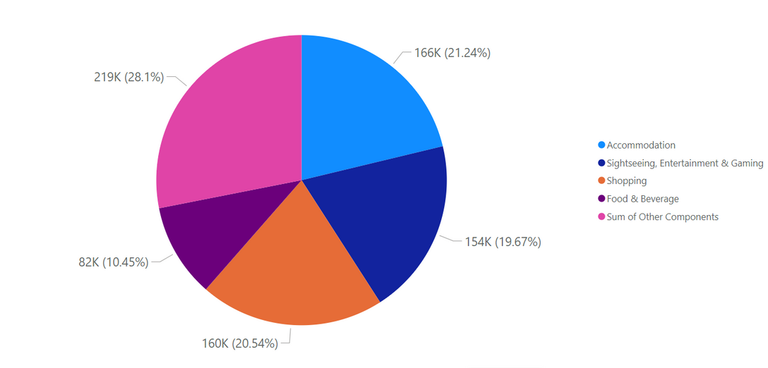
ANALYSIS
Distribution of top factors affecting Tourist Spendings
Accommodation occupies 21.24% of total Tourist Spendings, ranking 2nd overall against the other Sectors, 1st being “others”.
However, “Others” consists of multiple categories and should not be considered in this analysis.
As such, we will be focusing on Accommodation.

Slide 23
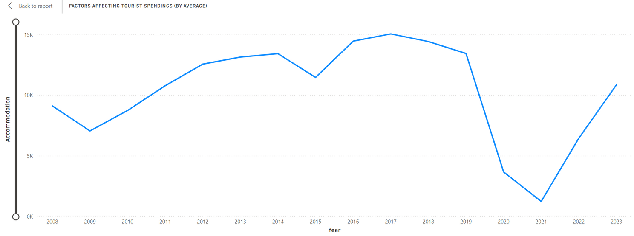
ANALYSIS
The graph below showcases Accommodation Revenue in Singapore.
Accommodation revenue has been on a steady trend until 2019 (13440M, pre-covid).
Dropped due to covid-19 the lowest being in 2021 (1231M, lock-down).
Exponential growth after 2021 reaching back to pre-covid levels during 2023 (10849M, post-covid).

Slide 24
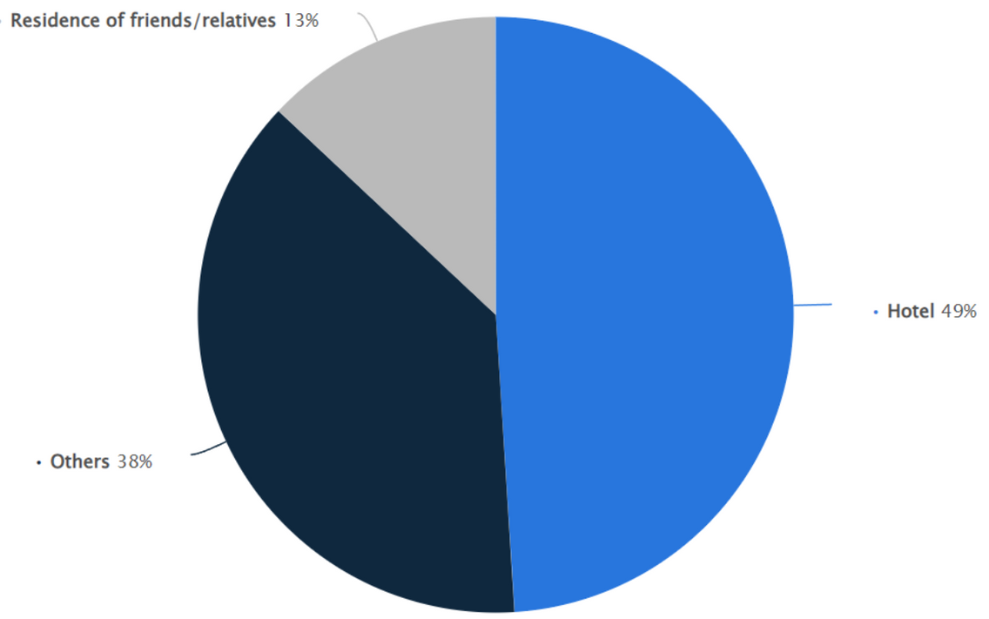
ANALYSIS
The Pie Chart below shows the
Accommodation choices of visitors to Singapore in 2023
Why use Hotels as the key point of Accommodation?
Hotels take up 49% of Accommodation choices of tourists in the pie chart by Statista.
As such, visually showing that Hotels are a major component of Accommodation.
https://www.statista.com/statistics/1100201/singapore-visitor-accommodation-breakdown/#:~:text=Accommodation%20choices%20of%20visitors%20to%20Singapore%202023&text=In%202023%2C%2049%20percent%20of,for%204.47%20billion%20Singapore%20dollars.

Slide 25
ANALYSIS
Note:
Due to limited resources, we are only able to use datasets from gazetted hotels. (Hotels registered with the Singapore Tourism Board).
However, since the use of hotels are generalised, we can safely assume that the limited amount of hotels available in the dataset can reliably represent all Hotels.

Slide 26

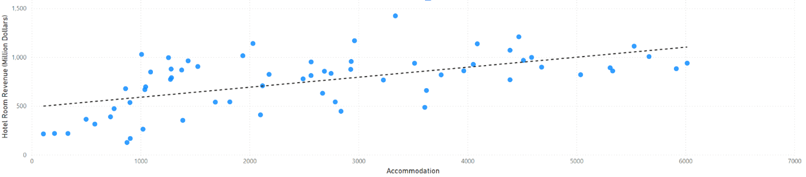
ANALYSIS
The Graph below shows the best-fit line of Hotel Room Revenue against Accommodation
Through the use of scatter plot, we are able to determine the best-fit line for the analysis of the relationship between Hotel Room Revenue and Accommodation.
There is correlation between the axises. Hence we can conclude that they have a proportional relationship.
The hotel dataset is a major reliable subset of Accommodation.

Slide 27
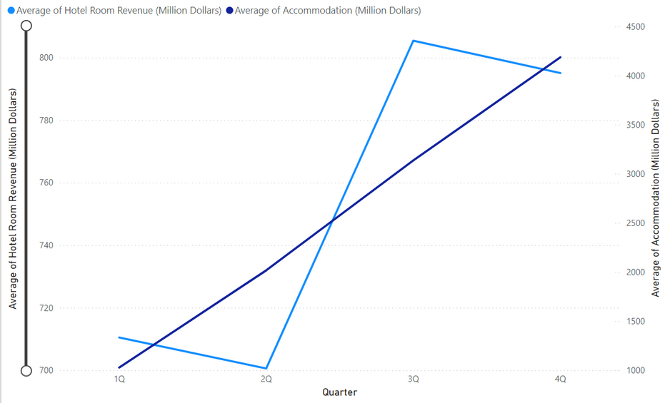
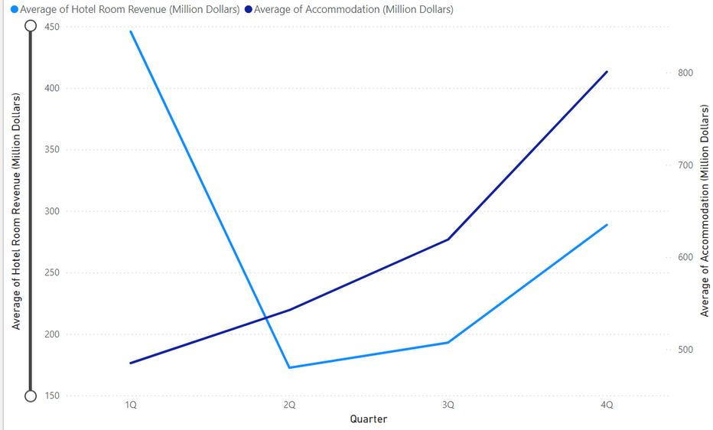
ANALYSIS
Overall Hotel Revenue and Accommodation trend:
2020-2021 Hotel Revenue and Accommodation trend:
Hotel Room Revenue often peaks at Q3
Where as Accommodation peaks at Q4
Hence, our optimal timing will be between Q3 and Q4 (July-Dec)
The only exception of this trend is during the 2020-2021 period, where Hotel Room Revenue peaked at Q1 instead

Slide 28
RESULTS
Based on the results collected and analyzed, we can be assured that through leveraging Hotels, we can greatly boost the accommodation sector of Tourism, yielding great benefits for Singapore.
Accurately gauging peak tourism activity time frame in Singapore. Through making use of all the visualized data, we can find the time period where high volumes of tourists/foreigners come to Singapore for touring (Peak tourism activity), by tracking the revenue by Hotels(Accommodation).
Peak time would be in the range between Q3 and Q4 (July - November).

Slide 29

DATA MINING GOAL:
REVENGE TOURISM

Slide 30
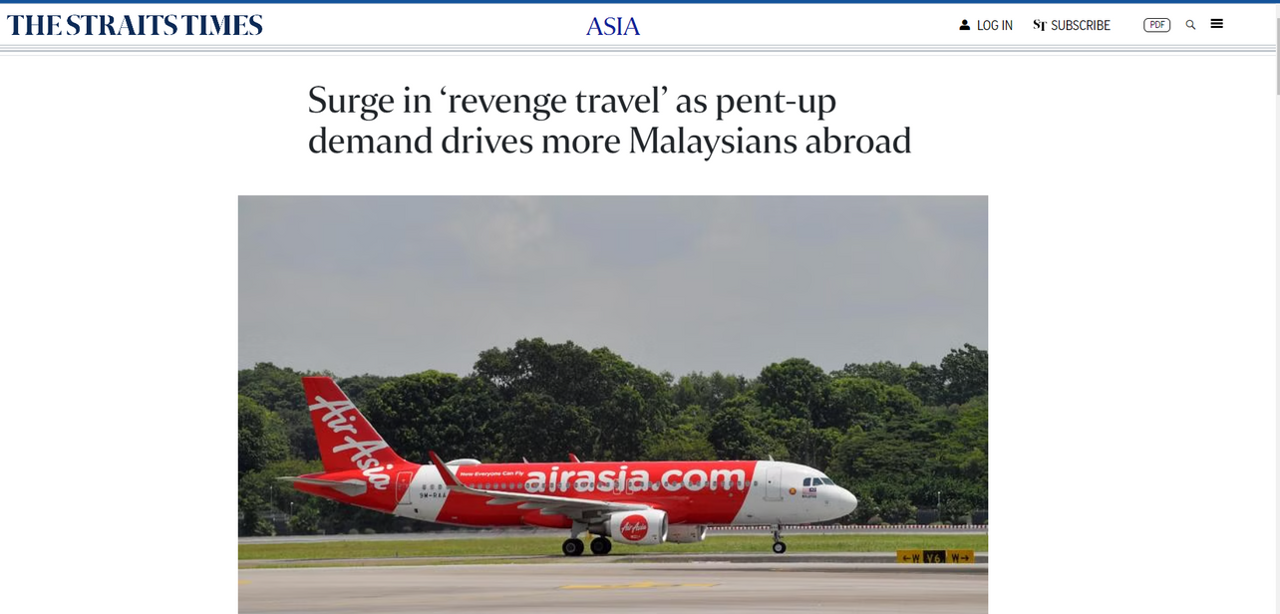
CONTEXT-WHAT IS REVENGE TOURISM?
Revenge Tourism is when people travel more frequently to make up for lost time previously, such as during Covid 19.
Singapore is able to use Revenge Tourism as a great opportunity for financial recovery and stability in the tourism sector.
Source:https://www.straitstimes.com/asia/se-asia/surge-in-revenge-travel-as-pent-up-demand-drives-more-malaysians-abroad

Slide 31
REVENGE TOURISM
Due to revenge tourism, more tourists arriving in Singapore are willing to pay and spend more money despite increasing costs.
Singapore is able to seize this opportunity to increase prices further, allowing Singapore to increase tourism receipt without significantly affecting tourist arrivals negatively.
Hence, our third data mining goal is to identify whether revenge tourism is still viable in 2024. This includes identifying
if we can continue to raise the overall prices for tourists.

Slide 32
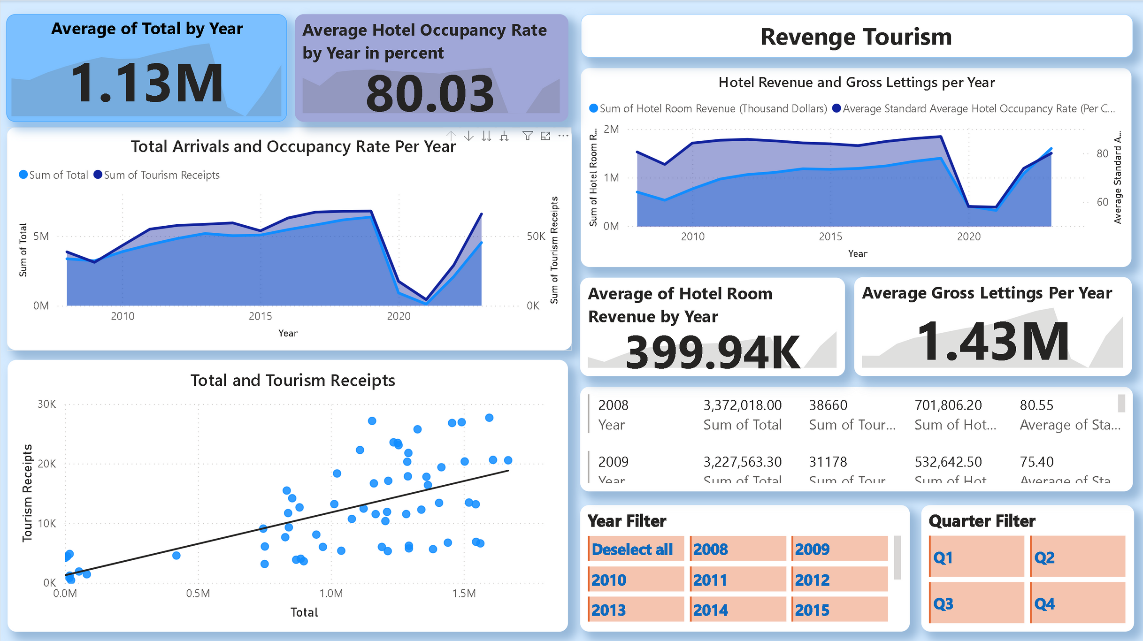

Slide 33
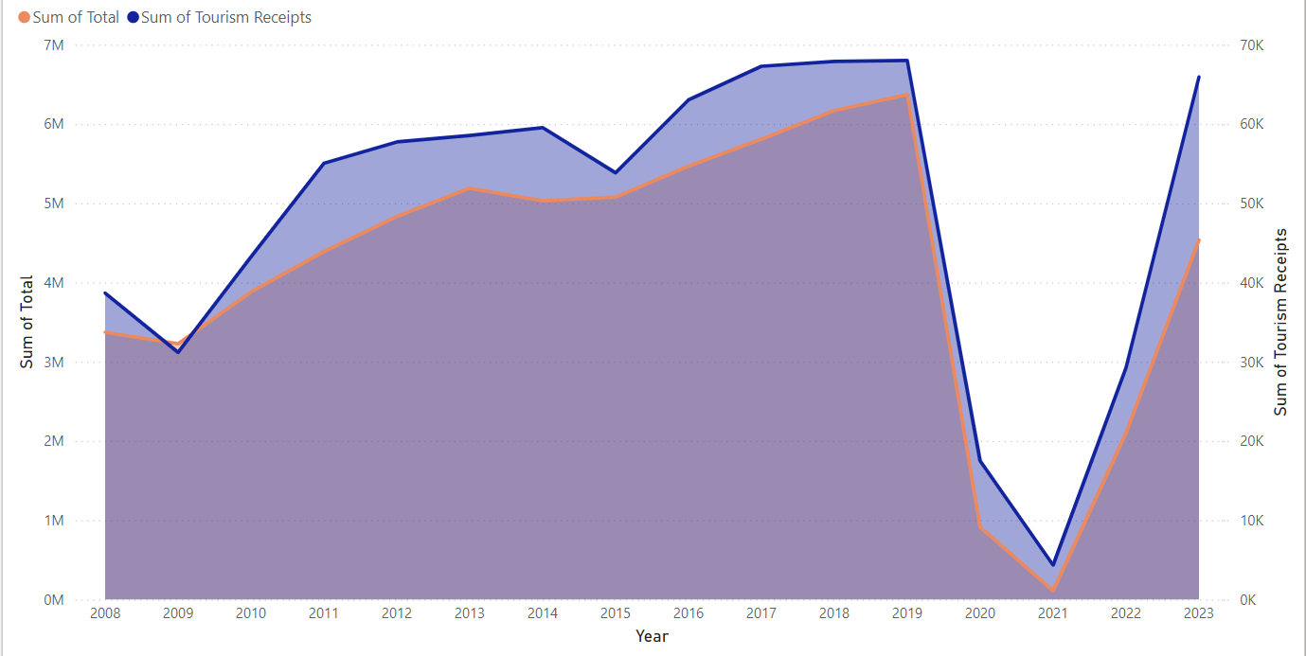




ANALYSIS
TOTAL ARRIVALS AND OCCUPANCY RATE PER YEAR
Total arrival and occupancy rates show a general upward trend from 2008 to 2022.
Decline in both lines around 2020
Post-2020, there is a recovery trend

Slide 34
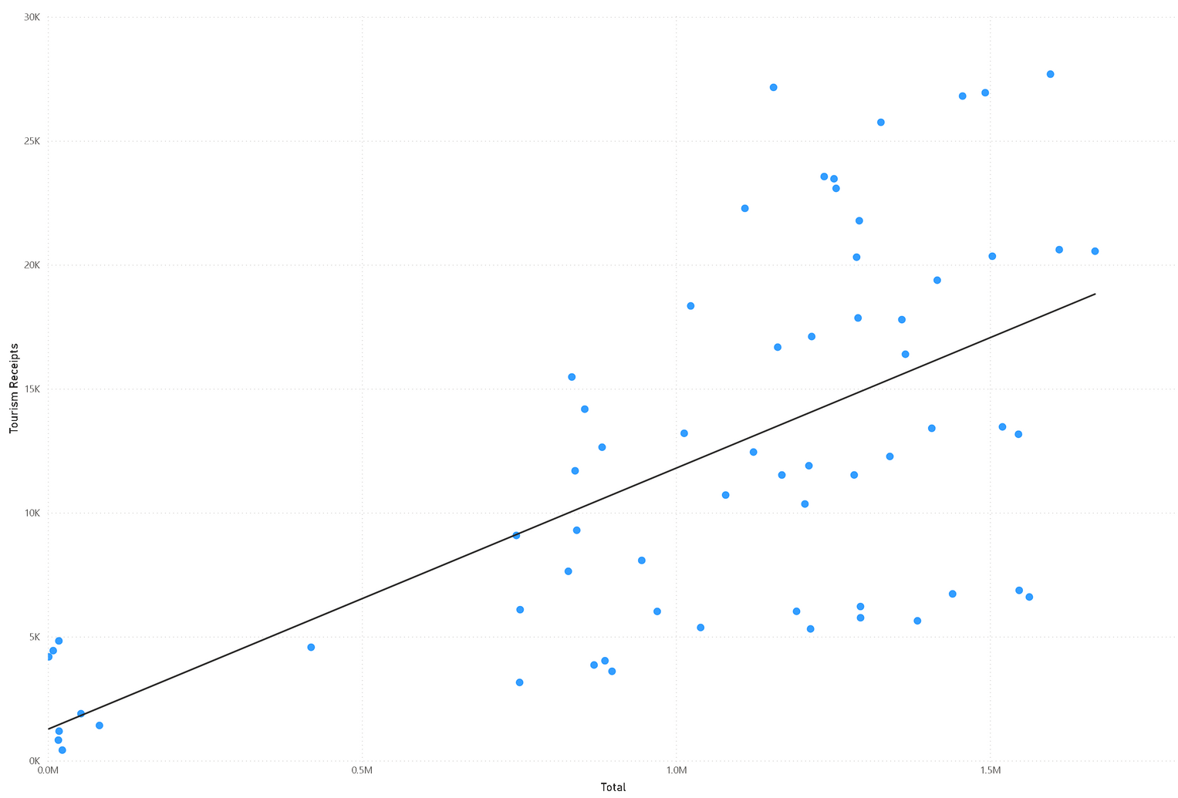

ANALYSIS
TOTAL ARRIVALS AND TOURISM RECEIPTS
low correlation (0.18) between total arrivals and tourism receipts

Slide 35
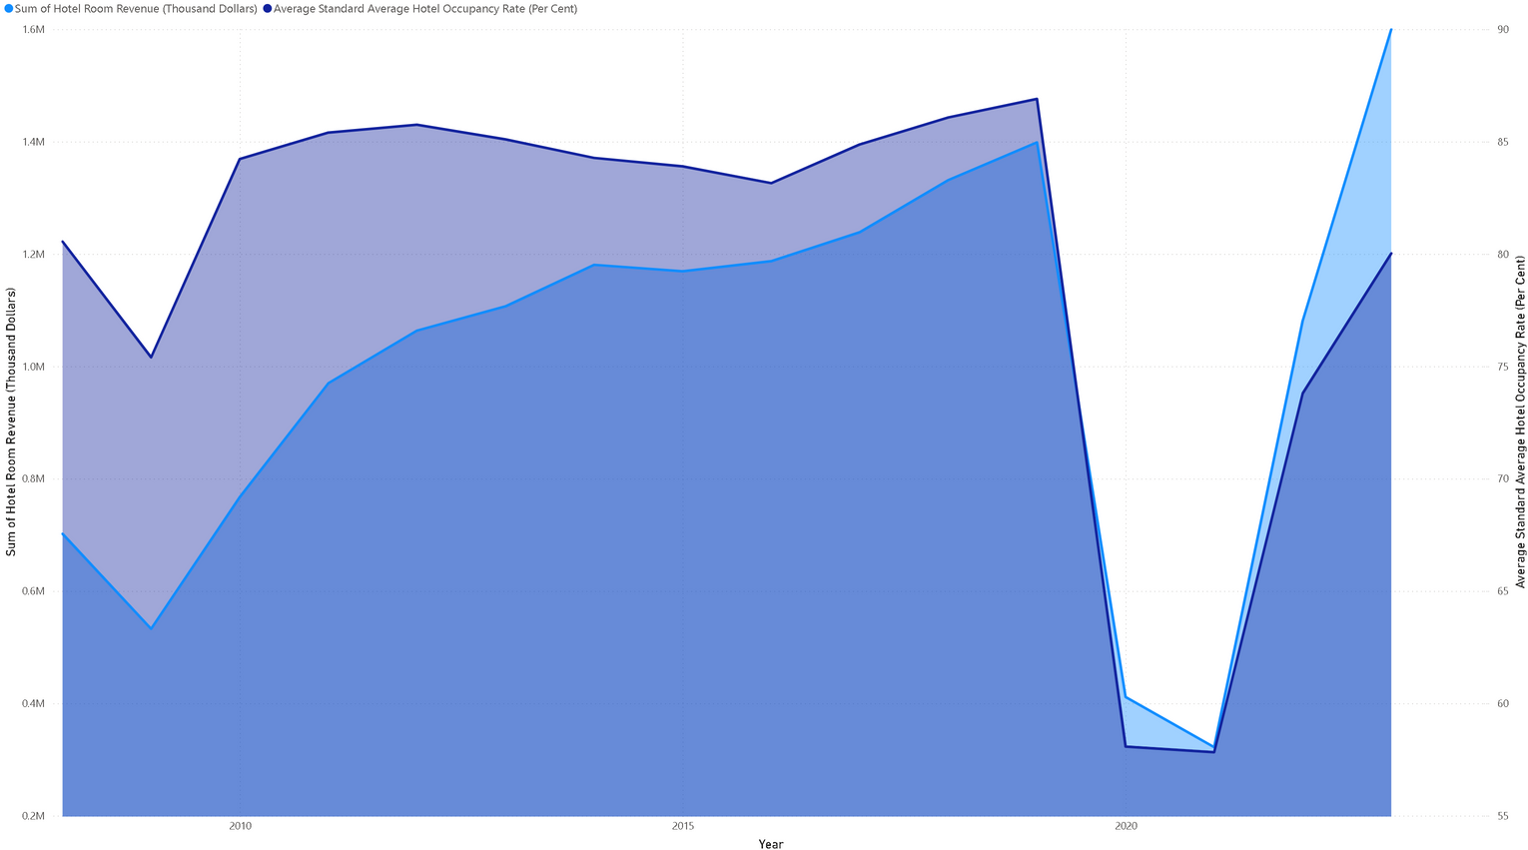


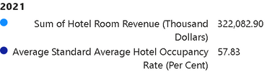

ANALYSIS
HOTEL REVENUE AND GROSS LETTING PER YEAR
Both average room rate and hotel revenue generally increased from 2008 to 2022.
Dip in both room rate and revenue around 2020
Recovery trend is visible post-2020, indicating a rebound
Total arrivals has not yet reached pre pandemic levels

Slide 36
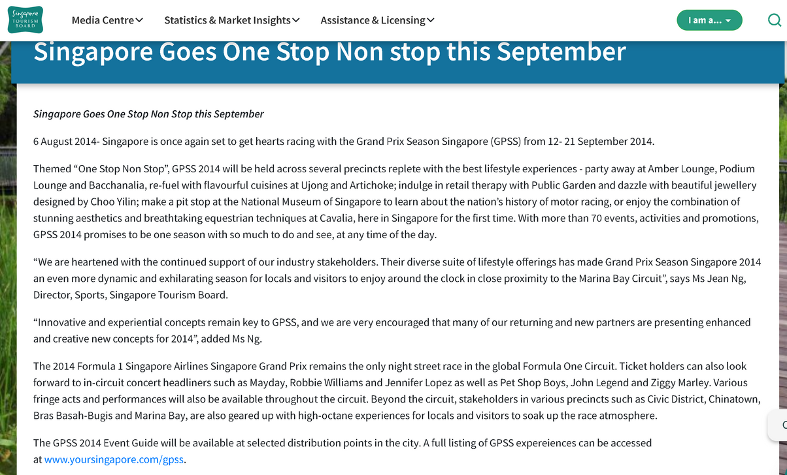
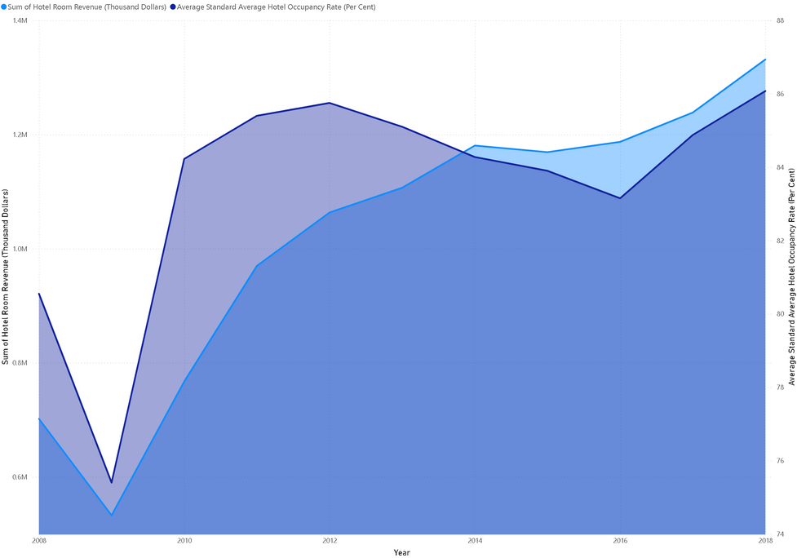
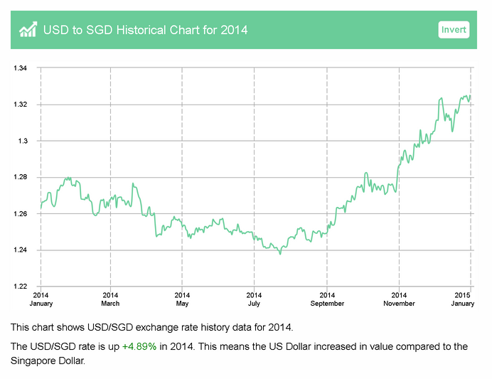
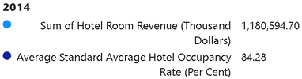

PRE-COVID
253,362 people came for the 2014 grand prix
https://www.stb.gov.sg/content/stb/en/media-centre/media-releases/singapore-goes-one-stop-non-stop-this-september.html
The USD/SGD rate is up +4.89% in 2014. This means the US Dollar increased in value compared to the Singapore Dollar.
2014 to 2018 showed more revenue compared to occupancy rate
https://www.exchange-rates.org/exchange-rate-history/usd-sgd-2014

Slide 37
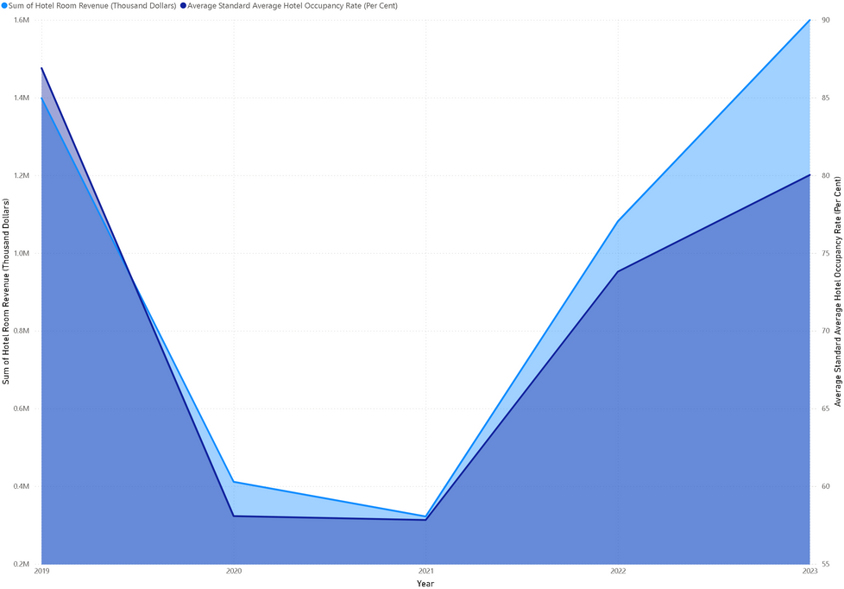
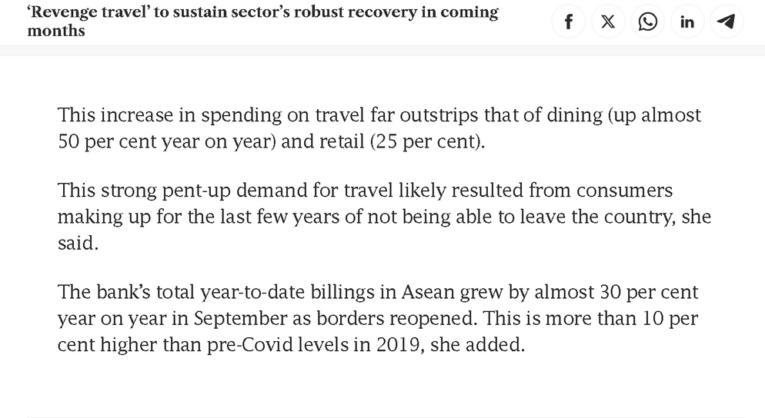


POST-COVID
Factors include revenge tourism
https://www.businesstimes.com.sg/international/asean/revenge-travel-sustain-sectors-robust-recovery-coming-months
2022 to 2023 total receipts grew faster as compared to the total arrivals

Slide 38
RESULTS
Despite the total number of tourist arrivals not reaching pre-COVID levels in 2023, the total tourism receipts grew at a faster rate. This indicates that tourists are spending more per visit compared to previous years.
There is a moderately low correlation (0.18) between total arrivals and tourism receipts. This suggests that while the number of tourists influences total receipts, other factors such as increased spending per tourist plays crucial roles in terms of actual revenue growth
yes we can leverage on revenge travelling as it appears to be a significant factor in this growth. After the severe restrictions and travel bans during the COVID-19 pandemic, tourists are eager to travel and spend, making up for the lost time and experiences.

Slide 39




CONCLUSION AND SOLUTION
targeted demographic(25-54 Y.O.) (China, India, Malaysia, Indonesia)
tourist trends( Quarter 3 to Quarter 4)
accommodation (hotels)
revenge tourism(yes, can still be done in 2024)
promotions
increase price
lower plane prices

Slide 40
THANK YOU!
Q & A

Slide 41
https://www.stb.gov.sg/content/stb/en/media-centre/media-releases/Singapore-Tourism-Sector-Emerges-From-2020-With-Greater-Resilience-and-Reinvention.html
https://www.stb.gov.sg/content/stb/en/media-centre/media-releases/Singapore-Tourism-Sector-Emerges-From-2020-With-Greater-Resilience-and-Reinvention.html
https://www.stb.gov.sg/content/dam/stb/documents/mediareleases/Impact%20of%20Covid-19%20on%20tourism%20in%20Singapore%20and%20the%20road%20to%20recovery%20and%20transformation%20by%20STB%20and%20Visa.pdf
APPENDIX
https://www.stb.gov.sg/content/dam/stb/documents/mediareleases/Impact%20of%20Covid-19%20on%20tourism%20in%20Singapore%20and%20the%20road%20to%20recovery%20and%20transformation%20by%20STB%20and%20Visa.pdf
https://www.straitstimes.com/asia/se-asia/surge-in-revenge-travel-as-pent-up-demand-drives-more-malaysians-abroad
https://www.stb.gov.sg/content/stb/en/media-centre/media-releases/singapore-goes-one-stop-non-stop-this-september.html
https://www.exchange-rates.org/exchange-rate-history/usd-sgd-2014
https://www.businesstimes.com.sg/international/asean/revenge-travel-sustain-sectors-robust-recovery-coming-months

